Slide 1




NSLC Major
Simulation
Neil ,Diego, Ian, Michael, Emiliano, Tommy, Abhilash, Danny
Notes:
Present

Slide 2
Objective
Action and Adventure Movies
Casting Company
Rank based on actor popularity, experience in more than one movie, movie ratings and budget vs revenue.
Notes:
Michael

Slide 3
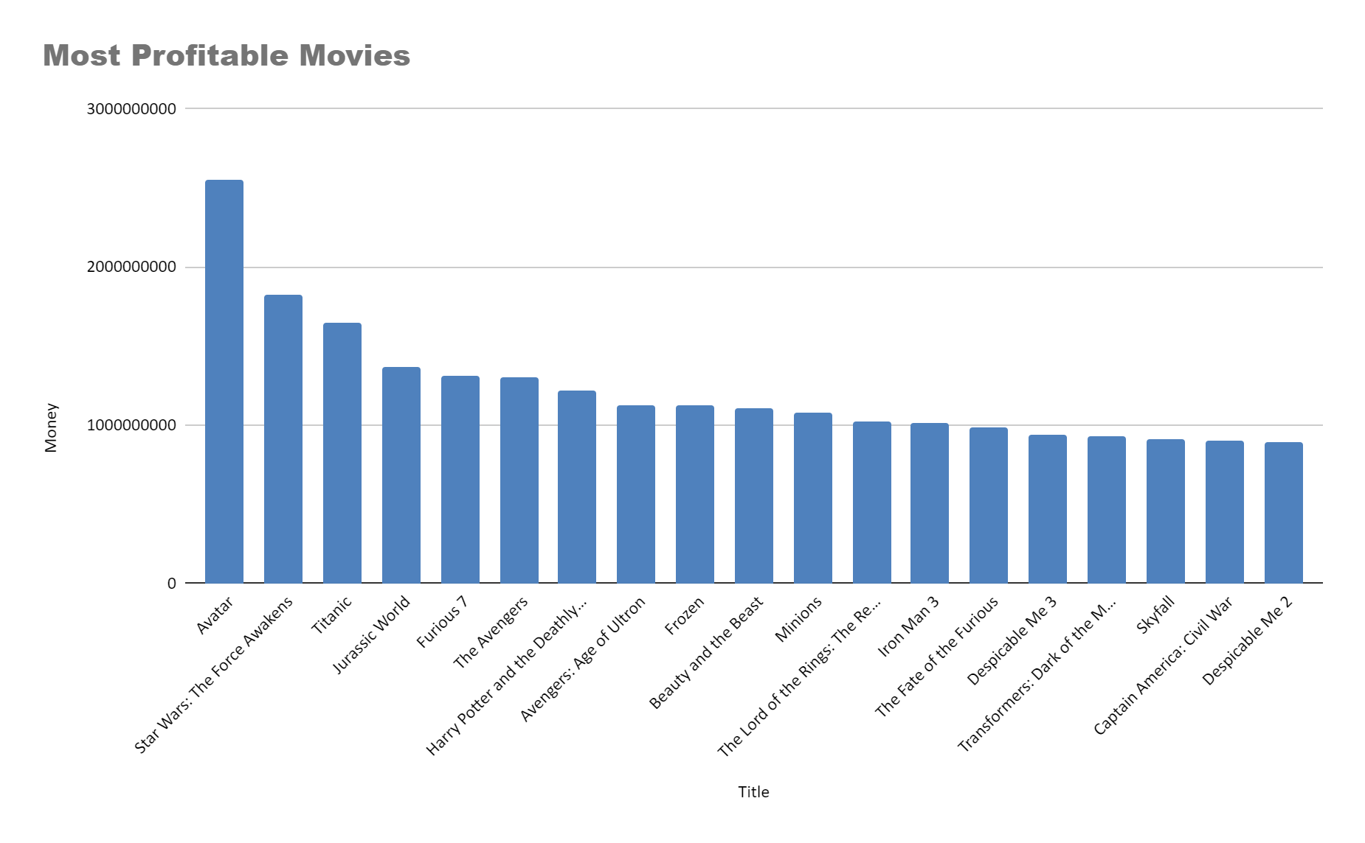
Most Profitable Movies
Notes:
Ian

Slide 4
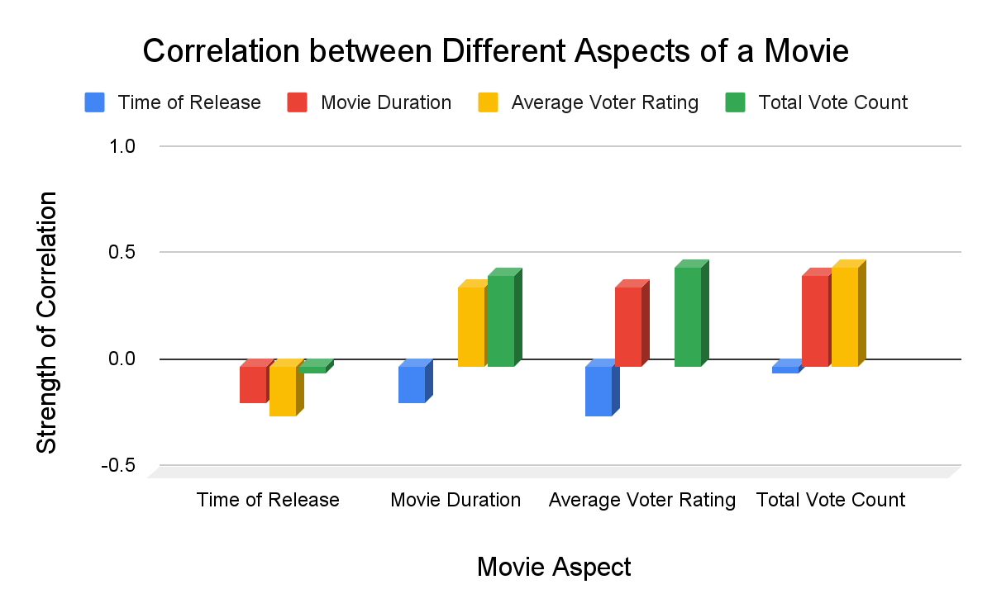
Correlation of Different Movie Aspects
Notes:
Abhilash

Slide 5
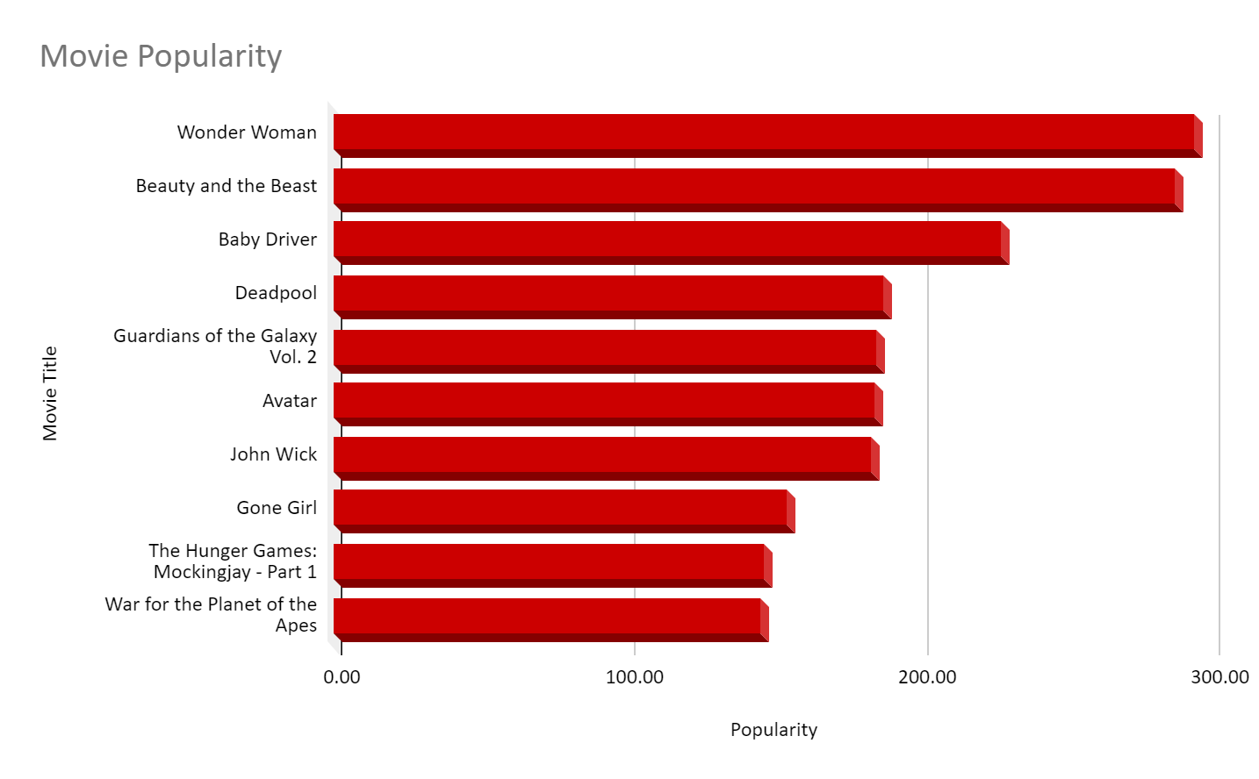
Most Popular Movies
Notes:
Ian

Slide 6
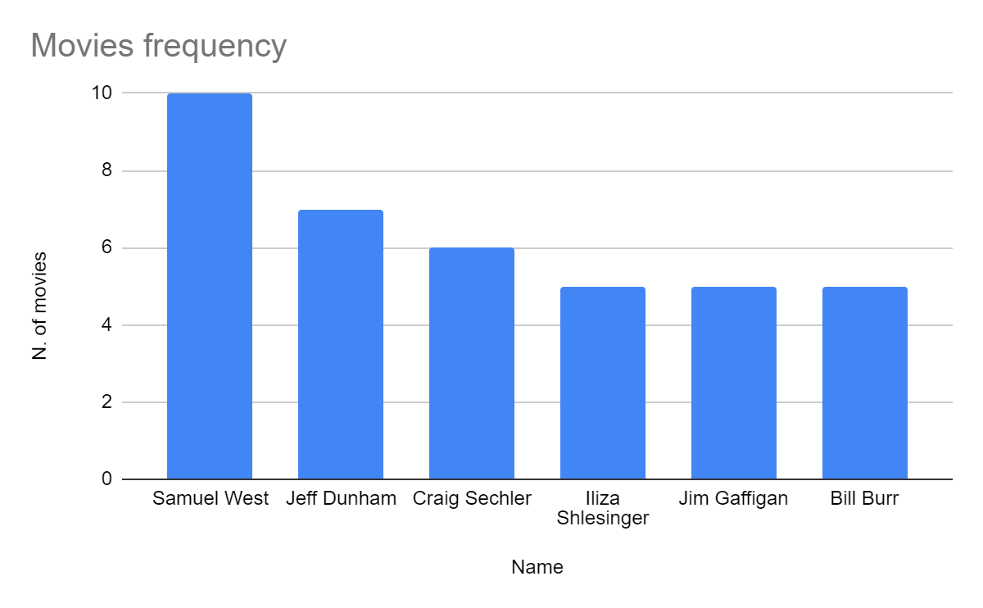
Most Experienced Actors*
Notes:
Tommy

Slide 7
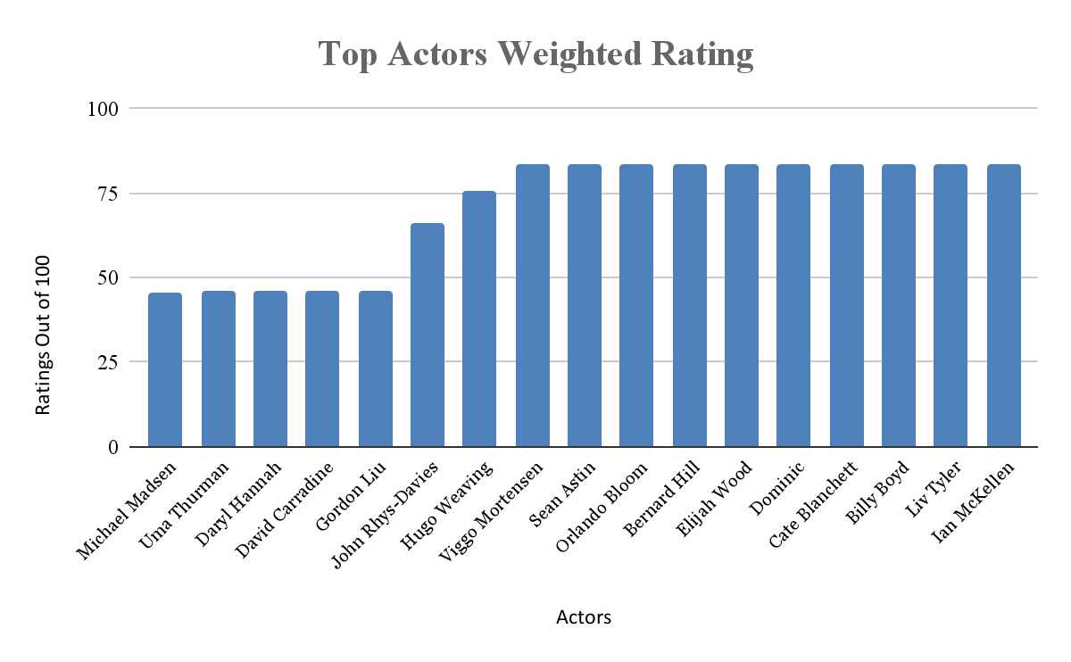
Weighted Actor Ratings
Notes:
Tiger

Slide 8
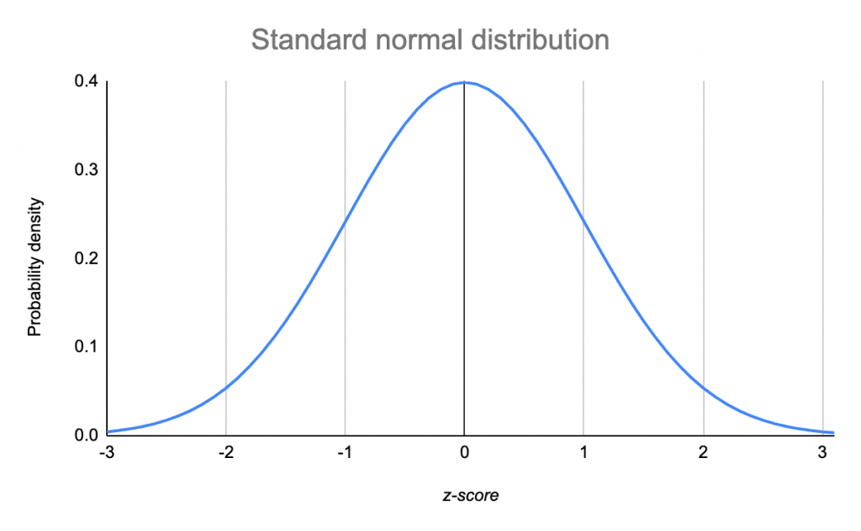
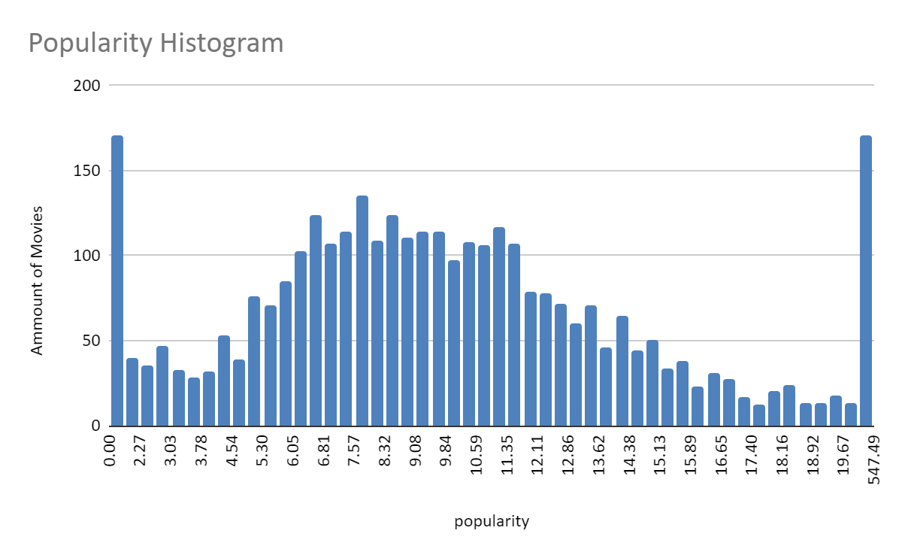
Statistics
Notes:
Emiliano

Slide 9
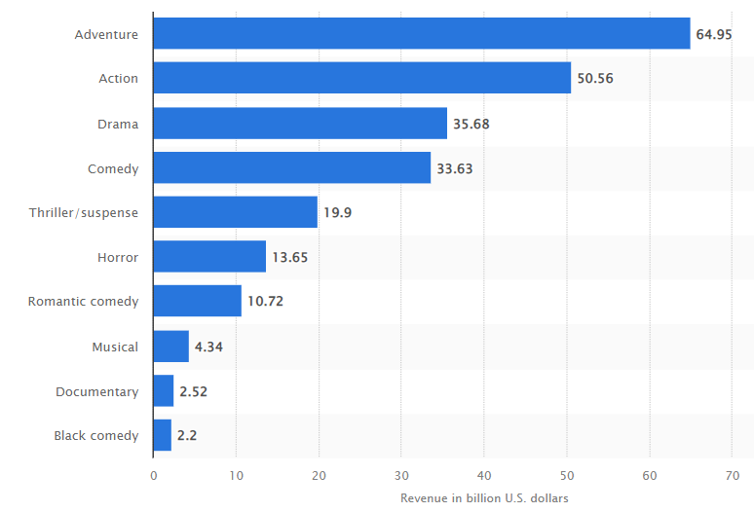
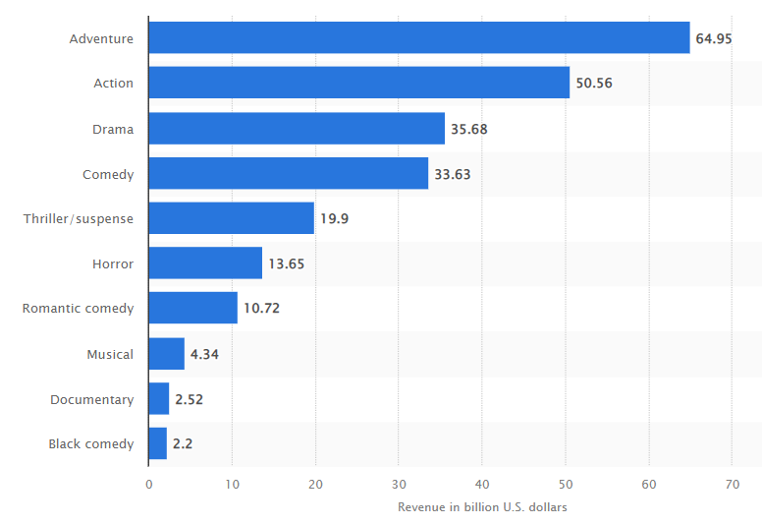
Income and New Viewers
Notes:
Diego

Slide 10
Top 8 Male and Female

Slide 11
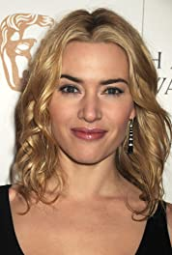
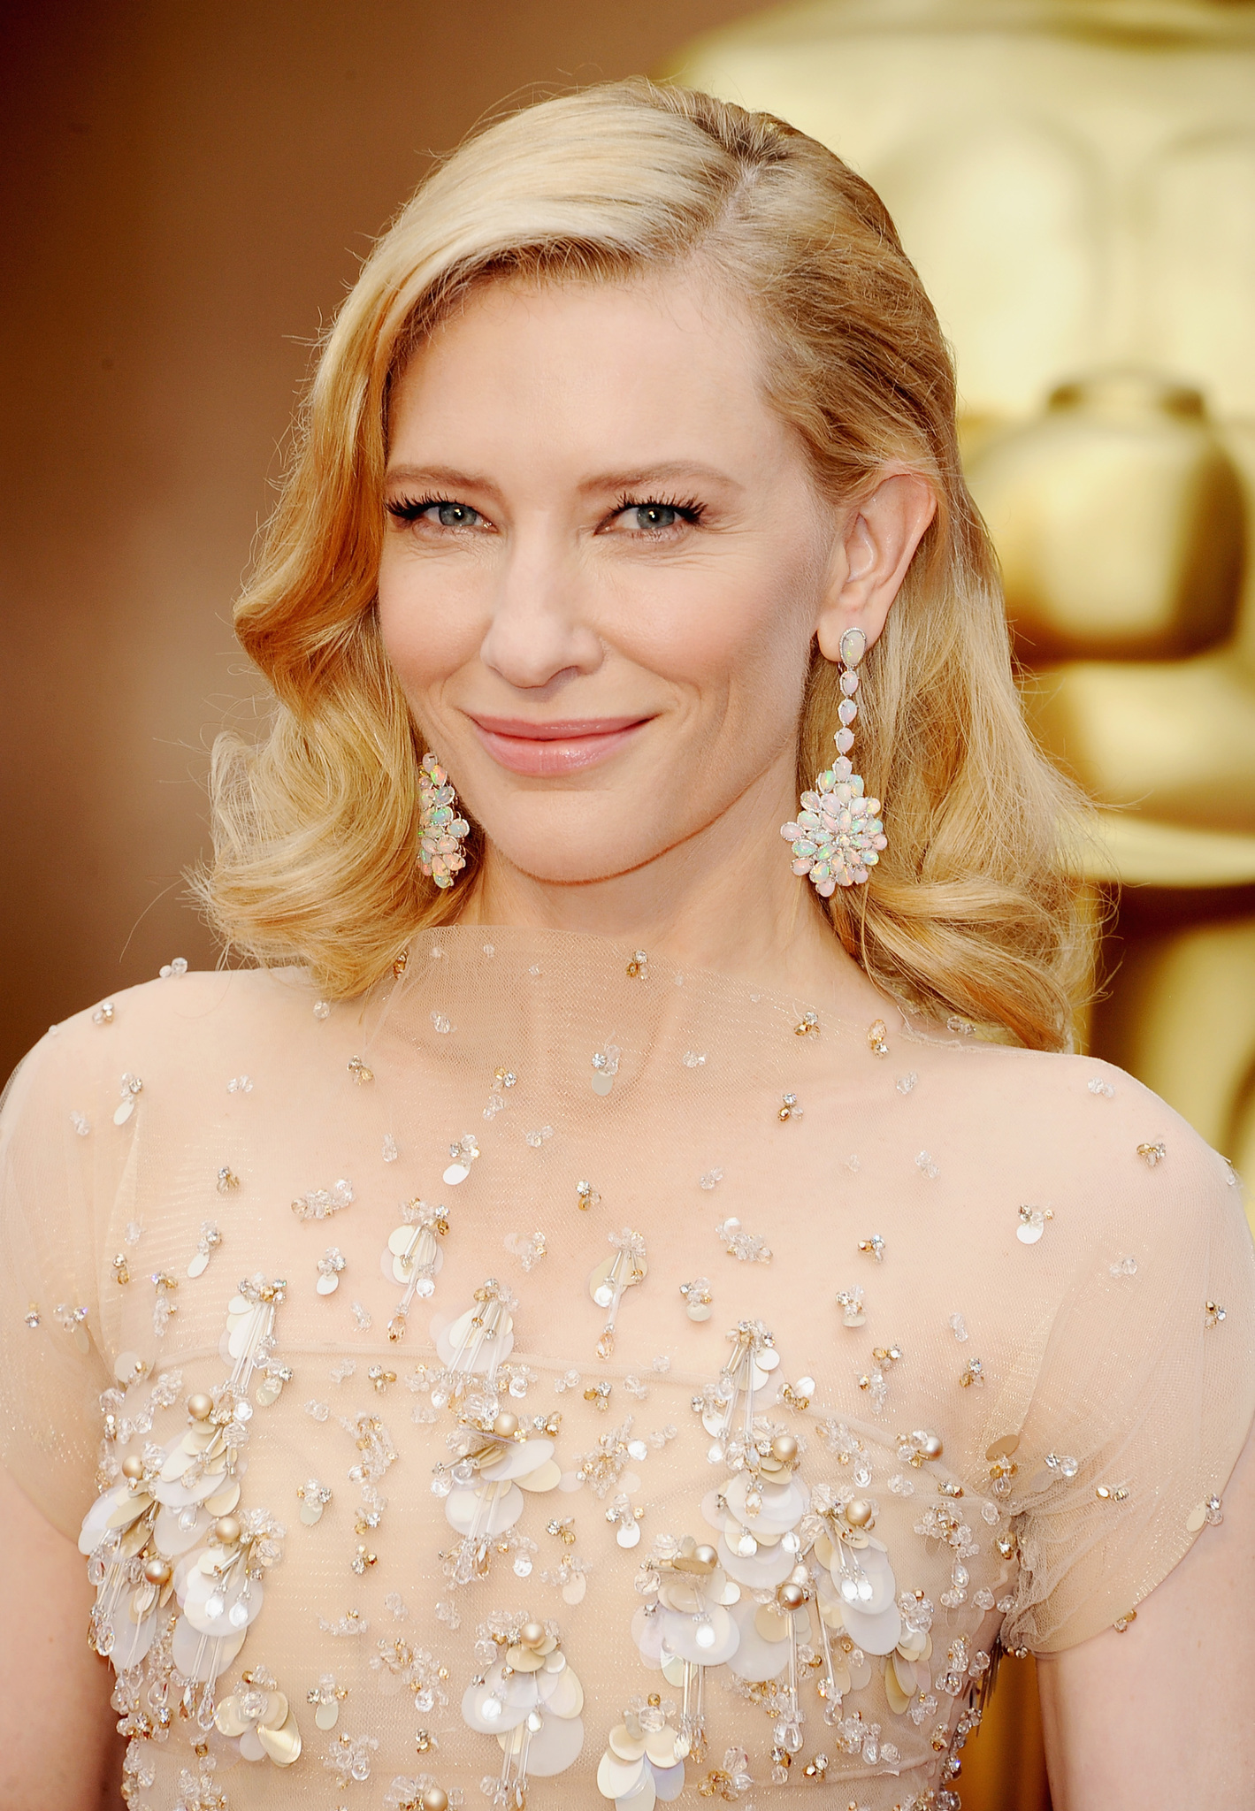
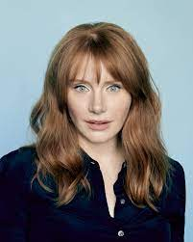
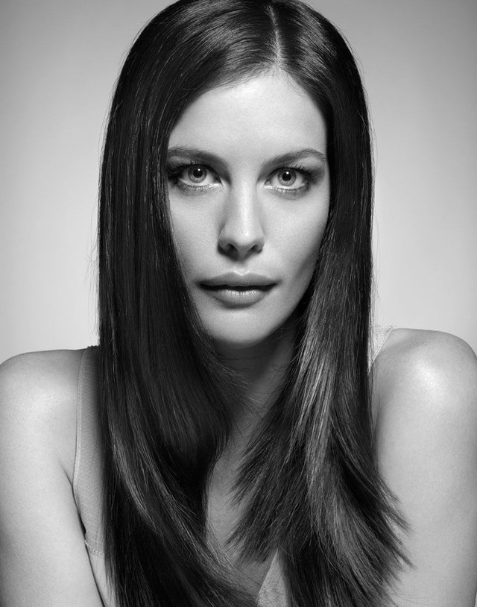
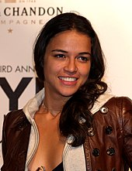
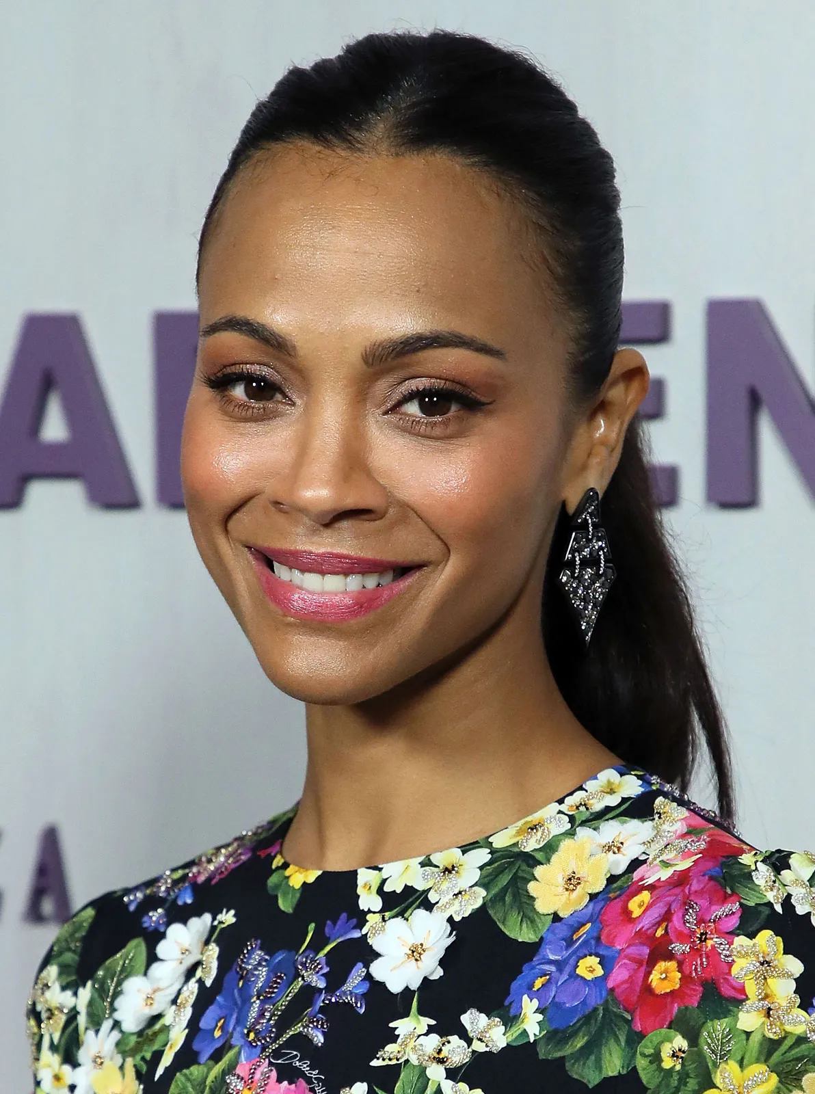
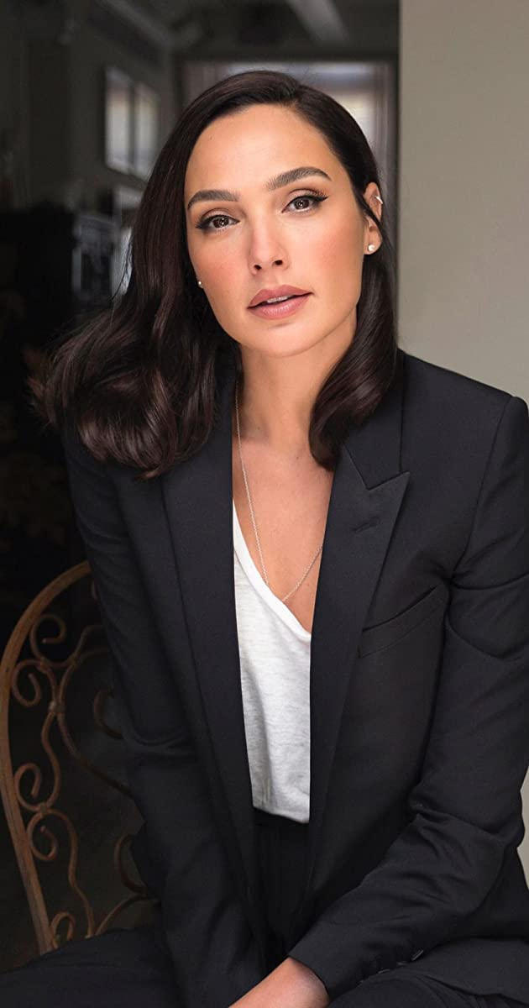
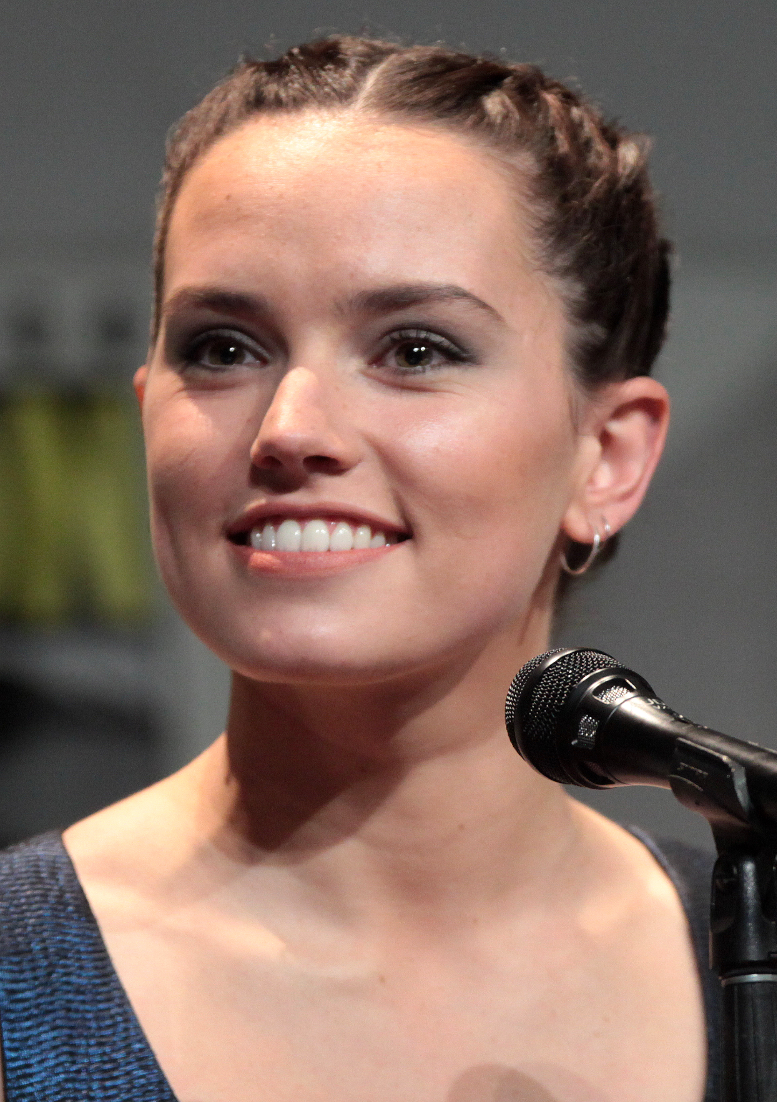
Female
Cate Blanchett
Liv Tyler
Zoe Saldaña
Daisy Ridley
5. Kate Winslet
6. Bryce Dallas
7. Michelle Rodriguez
8. Gal Gadot
Notes:
Danny

Slide 12
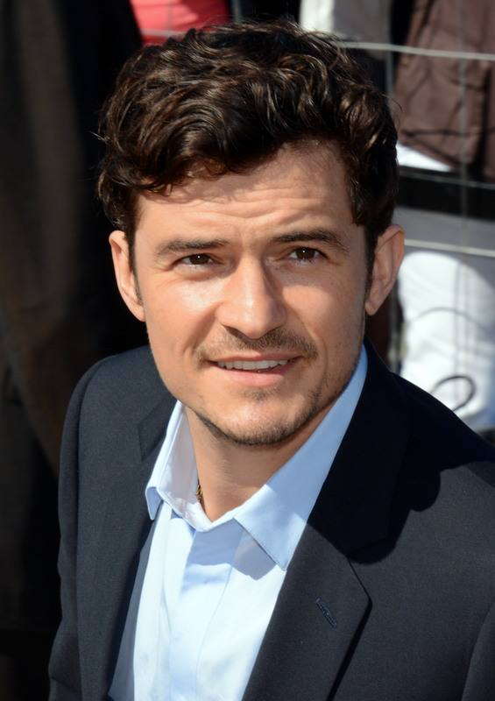
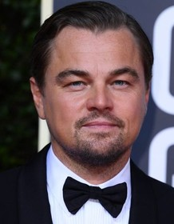
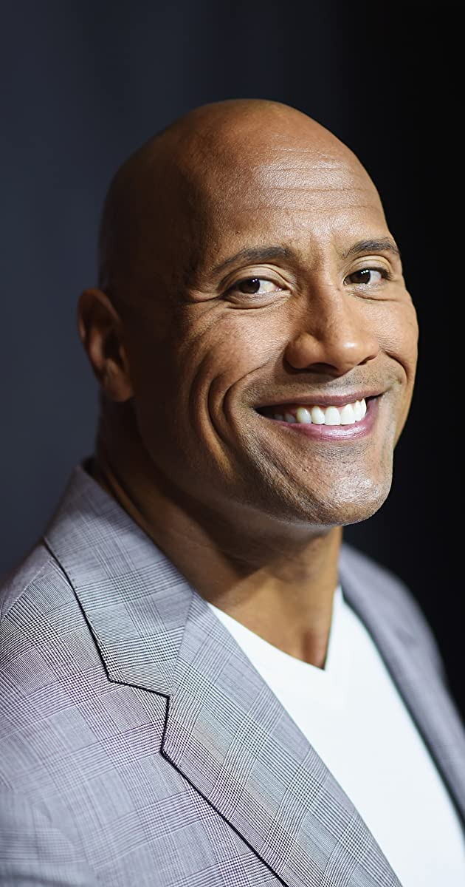
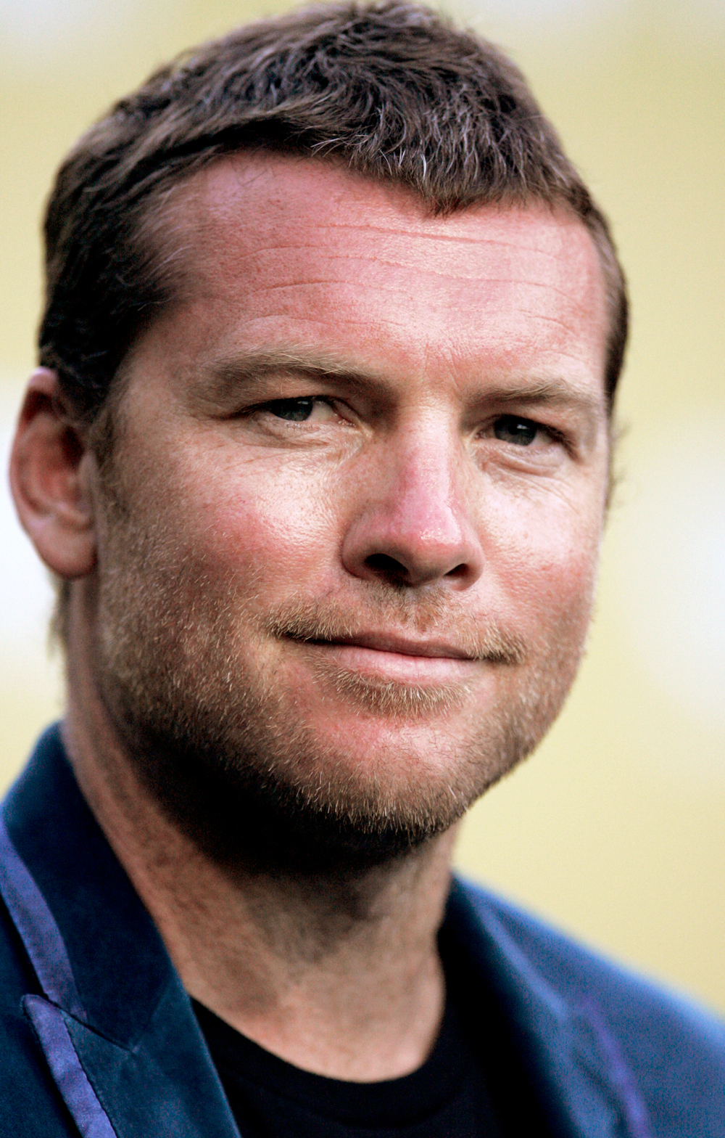
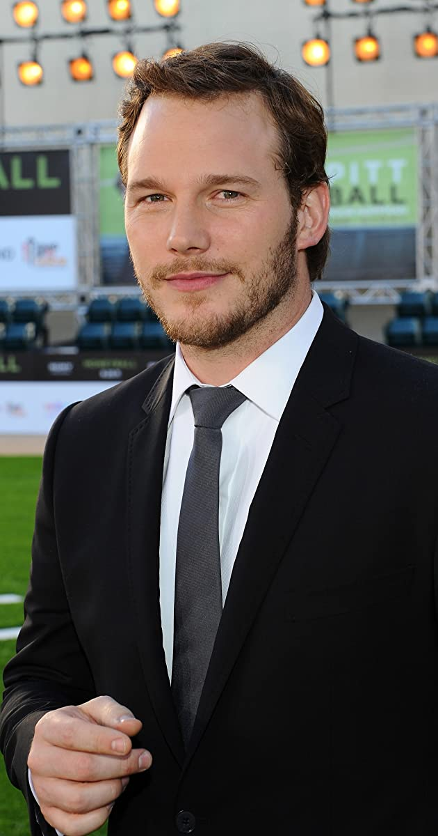
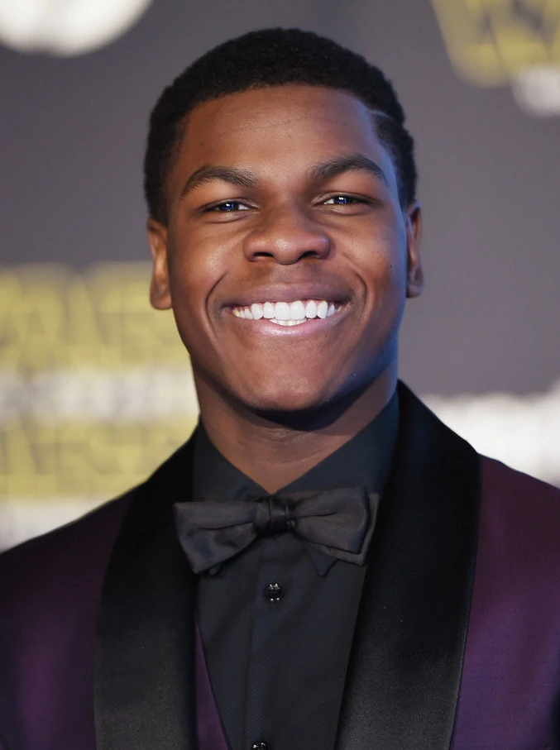
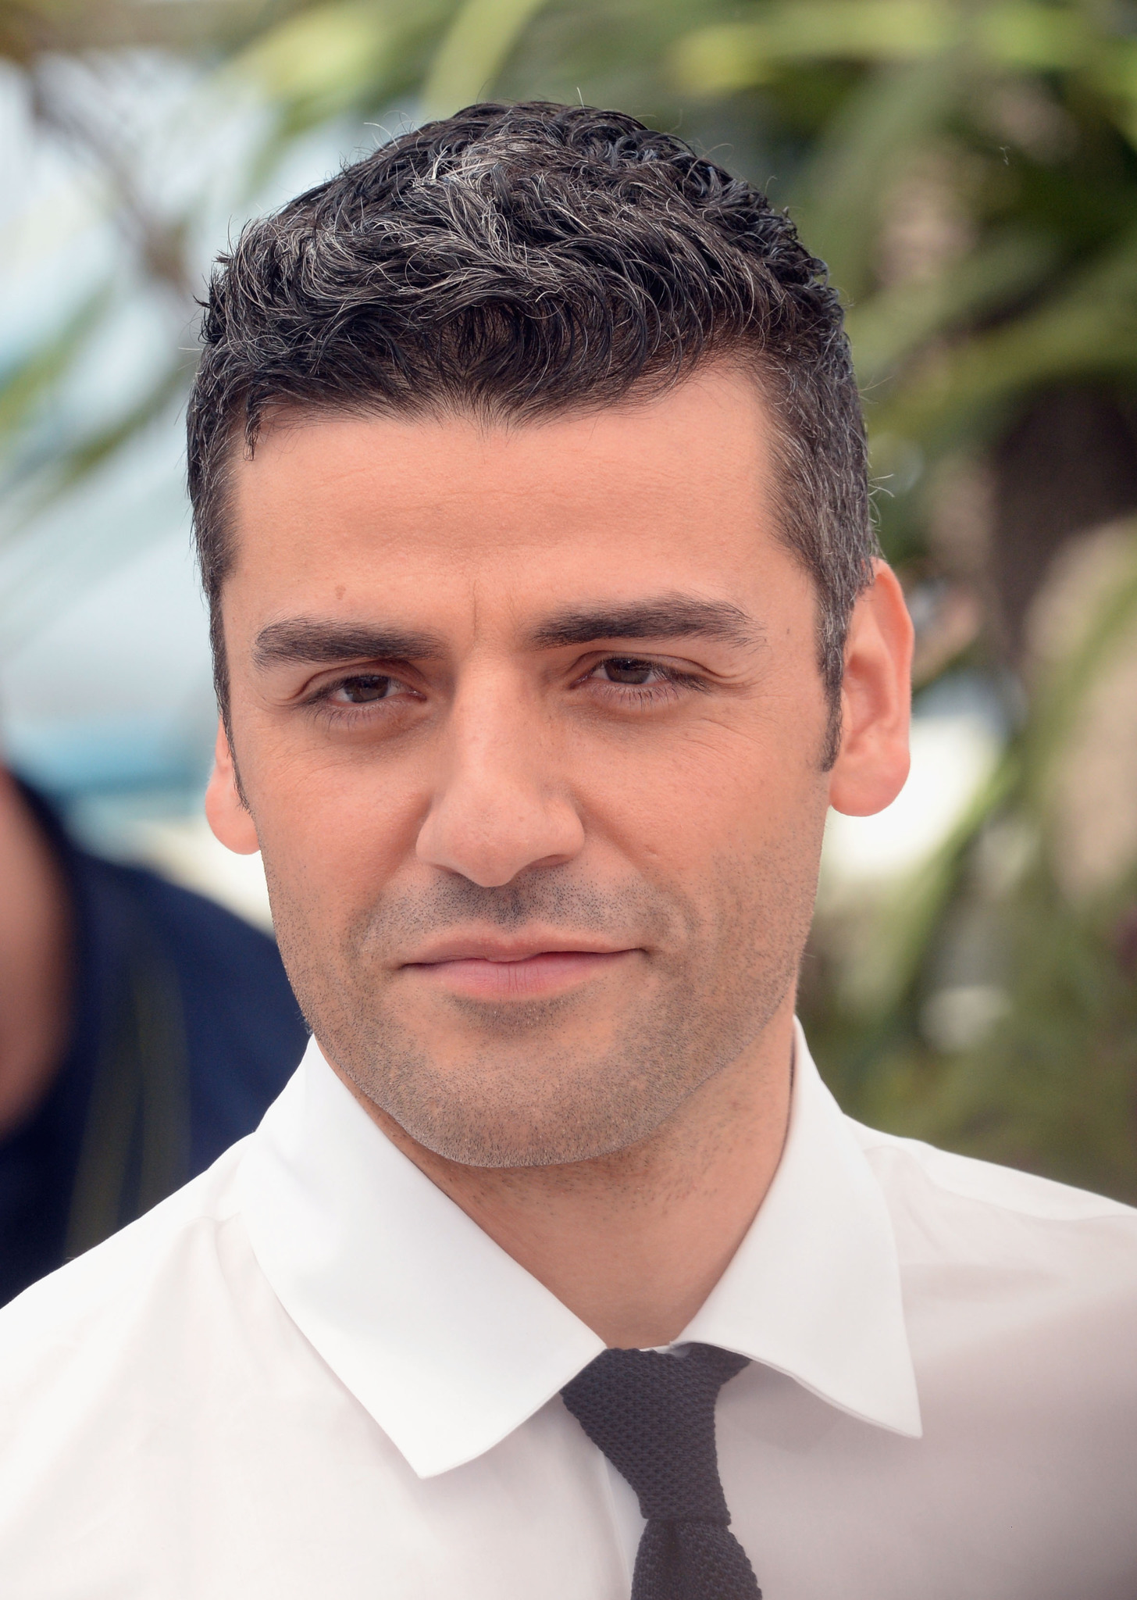
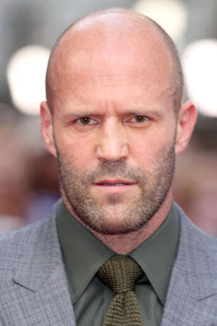
Male
Orlando Bloom
Sam Worthington
John Boyega
Oscar Isaac
5. Leonardo DiCaprio
6. Dwayne Johnson
7. Chris Pratt
8. Jason Statham
Notes:
Danny

Slide 13
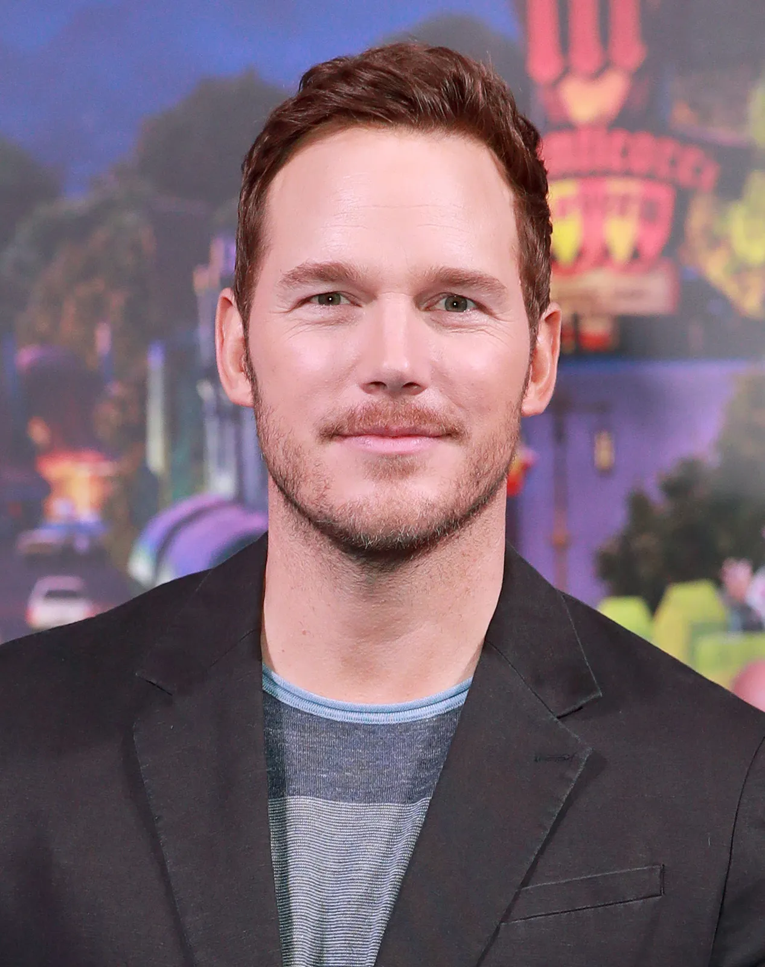
Final Decision
Chris Pratt
Cate Blanchett
AND
Notes:
Michael

Slide 14
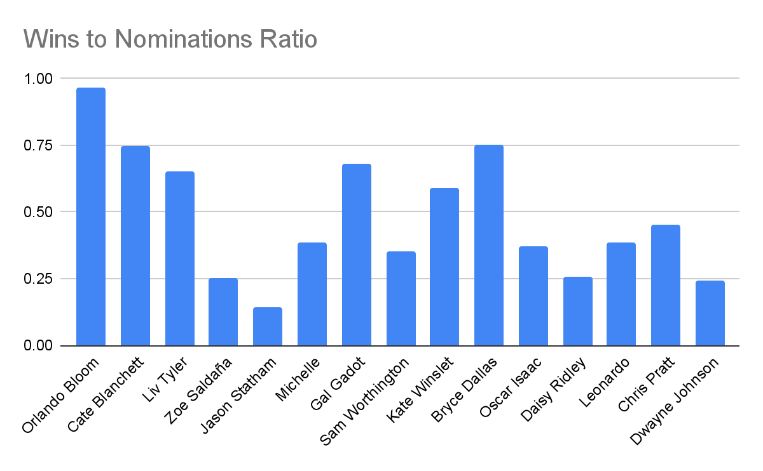

Slide 15
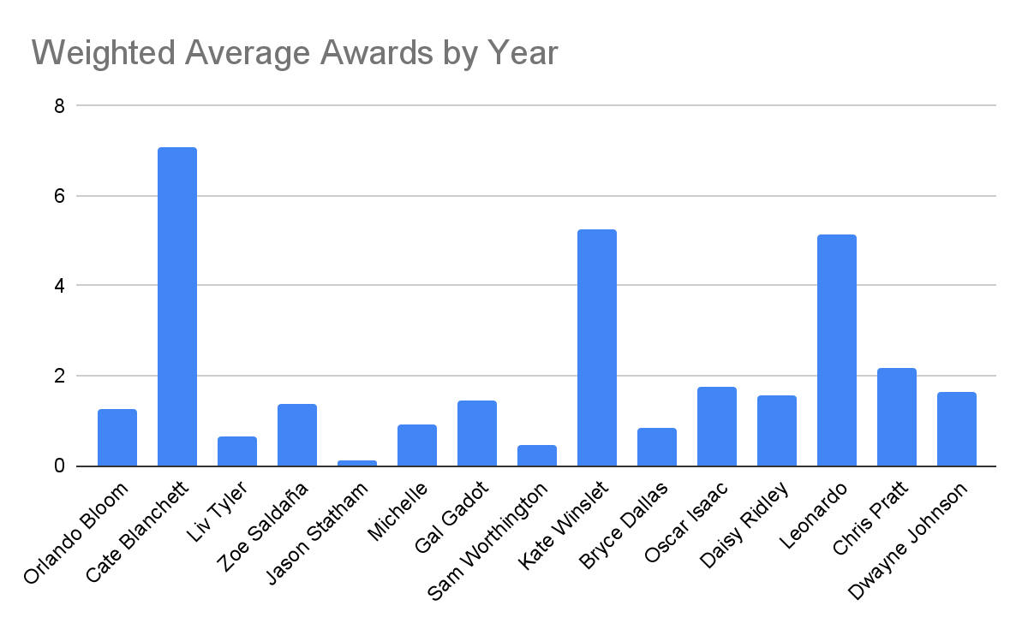
Notes:
Tommy

Slide 16

GitHub Repository
Name:
Sierra05082004 / Major-Simulation-Netflix (Public)
Link:
https://github.com/Sierra05082004/Major-Simulation-Netflix
#If you want to check the code
https://www.statista.com/statistics/188658/movie-genres-in-north-america-by-box-office-revenue-since-1995/

